Slide 1
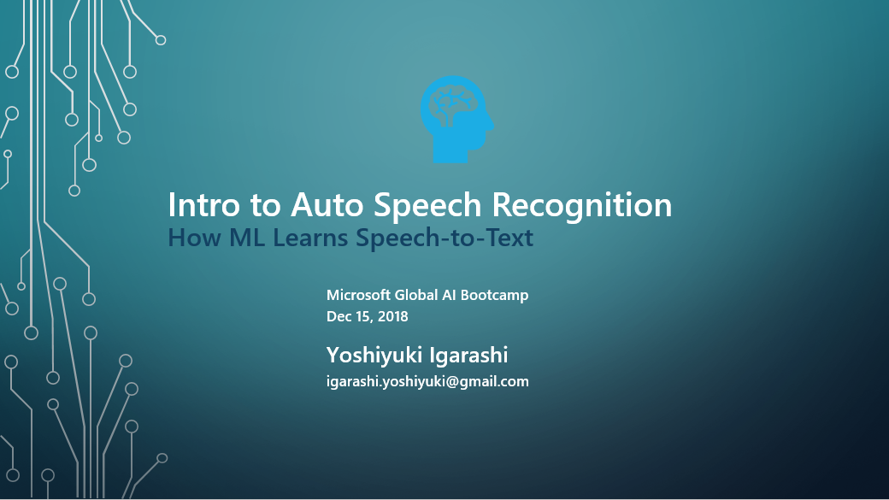

Slide 2

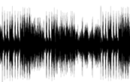

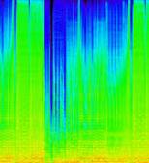

What is Auto Speech Recognition (ASR)?
Automatic Speech Recognition (ASR)
The technology of converting speech to written form (called speech-to-text) which human can interpret the meaning of text.
Hello,
how are you?
Voice
Speech Waveform
Feature from Audio
(e.g., Spectrogram)
Auto ML
Text
1/7
Notes:
The reason that the sample is discretized within a certain sample rate is that within around 25 mili-seconds, you speech signal is stationary.
Starting from raw speech waveform, we generate tiny slices, which is called speech frames, each speech frame represents a feature.

Slide 3

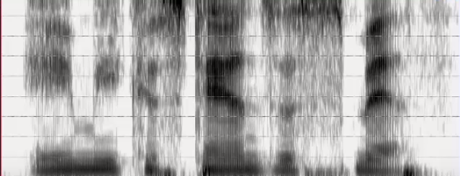
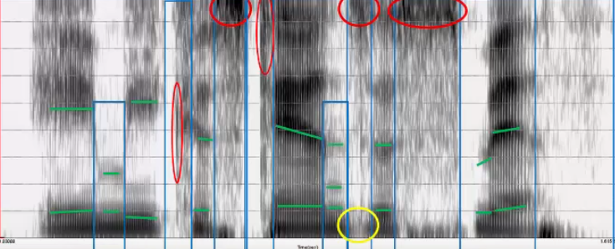
How to Understand Speech: Approach by Educated Human
Reading Spectrogram
source: Step by step through a spectrogram, https://www.youtube.com/watch?v=lfZ6XSRaRR8
2/7
Notes:
Amy Costanza Smith

Slide 4
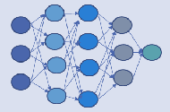

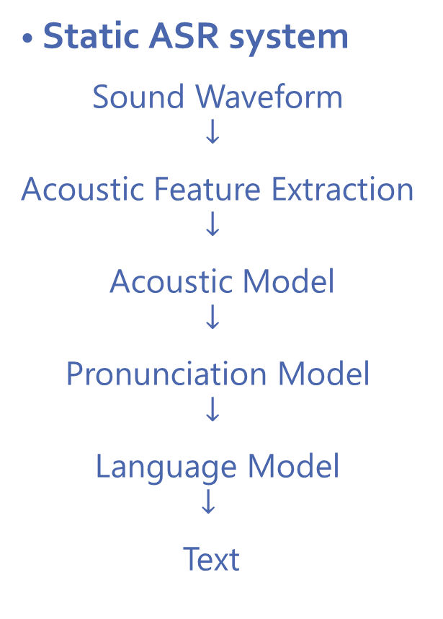
How to Understand Speech: Approach by AI
Static ASR system
Sound Waveform
$$↓$$
Acoustic Feature Extraction
$$↓$$
Acoustic Model
$$↓$$
Pronunciation Model
$$↓$$
Language Model
$$↓$$
Text
End-to-End Neural ASR System
Sound Waveform
$$↓$$
Acoustic Feature Extraction
$$↓$$
Acoustic Model with DNN
$$↓$$
Language Model with DNN
$$↓$$
Text
(Graves, Jaitley, 2014, “Towards End-to-End Speech
Recognition with Recurrent Neural Networks”, ICML)
(Chan et. al., 2016, “Listen, Attend and Spell: A Neural Network
for Large Vocabulary Conversational Speech Recognition”, ICASSP)
3/7

Slide 5
Challenges in a System Using Only Acoustic Model
Word | “Probably”
Dictionary Pronunciation | pr aa b ax b l iy
Actual pronunciations (many common ways to pronounce) | p r aa b iy
 | p r aw l uh
 | p r aa l iy
 | p aa b uh b liy
 | p ow ih
 | p aa iy
 | p r ah b iy
(Preethi Jyothi, 2017, “Automatic Speech Recognition - An Overview”)
Language Model
probably (p r aa b iy)
probability (p r aa b iy)
I
play tennis.
4/7

Slide 6


Beyond Text – Insights
Voice
Sound Waveform
Feature
Auto ML
Text
Insights!
Insight
Topic Classification
Semantic Parsing and Question Answering
Customer Segmentation/ Prioritization
Summary Generation
5/7

Slide 7
Current Challenges in ASR
Noisy real-life conversion with multiple speakers
Robustness to variations in ages and accents
Integration of effort across multiple dialects with transfer learning
Embedded ASR system locally on mobile devices without internet connection
Bad channel conditions (intermittently dropping voice)
(Preethi Jyothi, 2018, “State-of-the-Art in Speech Technologies”)
6/7
Notes:
Academic Research Summit, which was co-organized by Microsoft Research, was held at the International Institute of Information Technology (IIIT) Hyderabad on the 24th and 25th of January 2018.

Slide 8
Great Study Materials on Speech Recognition at YouTube
Deep Learning Lecture Series
“CS231N Winter 2016”
Convolutional Neural Networks for Visual Recognition by Stanford University (Andrej Karpathy ver.), 16 videos
“CS231N Spring 2017”
Convolutional Neural Networks for Visual Recognition by Stanford University, 16 videos
“CS224N Winter 2017”
Natural Language Processing with Deep Learning by Stanford University, 19 videos
Auto Speech Recognition Sessions
Automatic Speech Recognition - An Overview
Presenter is Preethi Jyothi, IIT Bombay in Sep 2017
State-of-the-Art in Speech Technologies
Presenter is Preethi Jyothi, IIT Bombay in Jan 2018
Lecture 2 | Word Vector Representations: word2vec
Lecture 2 in Natural Language Processing with Deep Learning
Step by step through a spectrogram
Lecturer is Andy McMillin, Clinical Associate Professor at Portland State University
7/7

